Slide 1
GPC England
2018 Roadshow

Slide 2
Content
Contract update
Saving general practice
Recent developments
Sessional GPs update
GPFV update
Working at Scale support

Slide 3
Contract negotiations - update
Many issues facing General Practice outside contract and need to be addressed through other routes
Minimal changes planned for 18/19
Current contract negotiations yet to be completed
Pay uplift and expenses via DDRB, not direct agreement, due to lifting 1% pay cap
No changes to QOF (apart from uplift for CPI) – review for 2019/20 underway
Seeking commitment to uplift vacs & imms IoS, sickness and paternity payments
NHS England opposed to practices providing their patients with private minor surgery for non-NHS commissioned services

Slide 4
Contract update - funding
CCG allocation for 2018/19: £188m
NHS England can only offer within current budget:
1% pay uplift and expenses uplift
Population growth uplift
Indemnity increase cover
GPC cannot agree to another 1% uplift
Approaching the DDRB for pay and expense uplift (in line with other healthcare professionals)
BMA DDRB submission:
GP pay
Staff related expenses
Other expenses
SFE reimbursables (locum cover, study leave, retainer scheme etc)
Guardians of safe working
Cybersecurity measures
GDPR
DHSC DDRB submission:
1% budgeted for but need for more flexibility to address areas of skills shortage
Acknowledged problems with GP recruitment and retention

Slide 5
Contract update - indemnity
£30m uplift for indemnity for in-year rise in indemnity costs for 16/17 and £30m for 17/18
Paid to practices on a per patient basis and not weighted
Practice should reimburse all GPs – salaried and principals - in line with their individual payments
Reimbursement to individual GPs should be to cover the indemnity increases for the last two years
Locum GPs should ensure charges reflect their costs, including any increase in indemnity costs
Guidance and template letters will be made available to salaried GPs and locums to help them make sure they get appropriate reimbursements
Discussions started on state-backed indemnity scheme from April 2019

Slide 6
Contract update – premises cost directions
Permit 100% improvement/development grants, with limited liability
Explicit options for owner-occupiers who hand back core contract
The Board can waive grant repayment for leaseholders who hand back core contract
The Board can assign a lease to their designated property body for leaseholders who hand back core contract
Lease terms will not be varied following a rent review
Practices will not be at risk of being financially disadvantaged by agreeing to host a third party at the request of the commissioner
Improved provisions for minimum standards reviews
“Focus on premises cost directions” guidance document to be released alongside new directions
GPC England calling for “premises commission” to look at wider issues and future arrangements

Slide 7
Contract update – Electronic Referral System
NHS Standard hospital contract changed such that from October 2018, hospitals will not be paid for referrals unless received through ERS
GPC is seeking that:
the ERS system will be fit for purpose
appropriate bandwidth for use
local contingency process if the system is not operational
resources for training and implementation
referral pathways developed as a result of ERS implementation agreed locally with GPs and LMCs
appropriate referrals received by the hospital through a non-ERS route will not be rejected on that basis, but processed internally
hospitals must reply to the referring GP
Joint guidance on ERS including how responsibility/liability flows through the system

Slide 8
Saving General Practice
Key areas to address:
Recurrent and sustainable funding and resources
A workforce strategy that is recurrently funded to enable expansion
A sustainable, long-term indemnity package for general practice
Manage workload to deliver safe services and empower patients and carers
Retention of a national core contract for general practice
Premises, IT infrastructure and administrative support

Slide 9
Recurrent and sustainable funding and resources
Problem: Underinvestment while increased workload and demand
Impact: GP crisis
Solution: Increase overall proportion of NHS spend in general practice, through recurrent funding
Progress: Lobbying government, using declining workforce stats, using BMA research into European comparators; funding is slowing increasing (but not enough and not fast enough)

Slide 10
GP share of NHS budget – projected change

Slide 11
Funding gap to reach 11% investment target
Investment in general practice (excluding drug reimbursement)

Slide 12
Workforce expansion strategy, recurrently funded
Problem: FTE GPs declining, GPs reducing time commitment or leaving, increased role substitution rather than expansion, time-limited funding
Impact: Longer appointment waits, practices unable to recruit, closing lists to new registrations or closing altogether
Solution: Genuine workforce expansion strategy, recurrently funded, flexible working initiatives, international GP recruitment, training grants, better use of funded MDT, promoting general practice positively
Progress: Medical school expansion with GP focus; 256 x £20k targeted enhanced recruitment scheme; improved induction/refresher and retainer schemes; recruiting internationally; clinical pharmacist scheme

Slide 13
GP Workforce - 5000 more GPs?
Current reality (excluding locums):
March 2017 – Sept 2017
39,002 GPs, a decrease of 558 (-1.4%) from 39,660
32,272 FTE GPs, a decrease of 700 (-2.2%) from 32,972
March 2016 – Sept 2017
Number of FTE GPs fell by 1953 (-5.7%) to 32272
Number of FTE consultants rose by 881 (2.0%) to 44513
Number of doctors in training rose by 843 (1.7% )to 50,969

Slide 14
A sustainable, long-term indemnity package
Secretary of State announced state-backed indemnity scheme for all GPs and practice staff from April 2019
Aiming to remove burden of indemnity from all NHS GPs and practice staff
Establish parity with hospital doctors
GPC discussions with DH have commenced
Potential survey shortly

Slide 15
Manage workload and empower patients
Problem: workload and demand rapidly grown over last decade, population increasing, underfunded workload shifting from hospitals, bureaucracy of regulatory reporting
Impact: Doctors leaving or not joining general practice, practices suspending patient registrations or closing, GP burnout
Solution: Practices to define capacity limits; warning systems for practices reaching unsafe working limits; locality hubs managed by practices; limit registration for patient safety; reduce bureaucracy and duplication; patient empowerment; reduce GPs’ role in non-NHS work; review collaborative service payments
Progress: Practice resilience programme >£17.2m (1279 practices 2016/17), £8m available in 2017/18; GP Health Service; significant changes to the standard hospital contract to reduce burden on practices; GPC defining safe workload and developing alert system

Slide 16
Managing workload
Enabling practices to improve quality and safety, and address recruitment and retention crisis, by agreeing safe workload limits
Providing practices with practical tools with which to achieve workload control
Guidance on safe working limits, by number and type of appointment
Development of clinical hubs to transfer work when practices are at capacity
Build on GP Access fund and urgent care plans
Black alert system – different levels depending on severity, prompting local action to reduce pressure

Slide 17
Managing and reducing workload: Primary-secondary care interface
Changes to the standard hospital contract 2016/17 and 2017-19, for example:
hospitals are responsible for providing patients with fit notes
hospitals to provide discharge summaries within 24 hours
Hospitals to stop asking GPs to re-refer DNA appointments
Helping practices and LMCs hold CCGs and trusts to account, by providing template letters to report and push back on breaches
Working with NHS England to communicate changes to trusts and patients (eg new patient facing leaflet)
Notes:
NHS standard contract changes:
2016/2017
Referrals - Hospitals to stop asking GPs to re-refer DNA appointments; - Hospital to make internal referrals for related problem and not ask GP to re-refer
Communication with the patient and fit notes - Hospital to follow up investigations and inform patient
Discharge summaries - Discharge summaries within 24 hours
Clinic letters - Clinic letters within 14 days
Drugs - Adequate supply drugs on discharge
2017/2018
Communication with the patient and fit notes - Hospital to put in place arrangements for handling patient queries (from patients and GPs); - Hospital to issue fit notes to patients where needed
Discharge summaries - Discharge summaries from A&E within 24 hrs and direct electronic
transmission from Oct 2018
Clinic letters - Clinic letters within 10 days (April 2017) and 7 days (April 2018) and move to electronic transmission using structured clinical headings (Oct 2018)
Drugs - Hospitals to provide medication following clinic attendance

Slide 18
Retain national core contract for general practice
Problem: Threat of APMS and ACO contracts, doctors unwilling to commit to becoming partners due to uncertainty, impacting recruitment, retention and premises developments.
Impact: Threat to quality health service for patients, continuity of care and working with communities long-term, loss of independent advocate, risk of a costlier service that loses the support of the public
Solution: Ongoing commitment to the national contract and independent contractor status; at-scale models built on the foundation of registered lists and GMS contract; collaborative working across local healthcare systems rather than single responsible body/employer; fully funded integrated urgent care service
Progress: Investment in GMS contract through national negotiations; Secretary of State speaking of commitment to partnership model; ACO contract guidance; government review of ACOs.

Slide 19
Premises, IT and admin support
Problem: insufficient investment, deterioration in premises, out of date/not fit for purpose, slow IT networks, outsourcing NHS backroom function problems
Impact: practices unable to accommodate latest innovations, practices handing back contracts because of premises, difficulties with data sharing, vulnerable to cyber-attack, patients at potential risk, destabilising practice finances, exacerbating workforce crisis
Solution: IT refresh; recurrent fully funded systems; end paper records; superfast data connections; fully functioning PCSE/back office support systems; premises commission; increased recurrent investment in GP premises
Progress: PCDs updated; challenging NHS PS and CHP; extension to STDL/VAT/legal fees programme; discussions regarding the replacement of GPSoC; GP2GP implementation progressing

Slide 20
Recent developments - GP at Hand
London based practice-commissioned App for online consultations
Available to any patient in England, but selective outside practice boundary
Massive increase in patient registrations – 4970 to 16,117 by January 2018
Patients not always clear they have left their current GP to access this service
Undermines principle of registered list and current funding model
Inappropriate use of out of area regulations
Data protection issues and blurring lines between NHS and private services
GPC written to and met with NHS England, requesting suspension of current registrations to allow full review to ensure patient safety and assess impact on other practices

Slide 21
Recent developments - PCSE
Survey of GPs, practices and LMCs provides further evidence of failure of NHS England to hit December 2017 deadline with decline in services and need for resolution across the board
Results and letter sent to Simon Stevens
Legal template letters (statutory demands) for practices and GPs to use to recoup incorrect payments
Exploring test cases on some service lines
FOI to provide information as to extent of PCSE problems
National Audit Office review of PCSE
Subject access requests
Writing to MPs and other political bodies

Slide 22
Recent developments - GDPR
New EU data protection regulations from May 2018; UK data protection bill currently going through parliament so potential for more changes
Key changes for practices:
Compliance must be actively demonstrated and documentation produced on request
More information is required in ‘privacy notices’ for patients
A legal requirement to report data breaches, and within 72 hours
Significantly increased financial penalties for breaches as well as non-compliance
Not charging patients for access to medical records (SARs) with shorter deadline for responding
Designation of Data Protection Officers
NHS England and ICO very slow in assessing impact and practicalities on general practice and preparing guidance
GPC guidance planned to be released early February

Slide 23
Recent developments - Scotland contract changes
Agreement to implement new contract from April 2018
Emphasis on GP as expert generalist
New funding formula
End of QOF (already commenced)
Minimum partner income of £80,430 (inc employers superannuation) pro rata by April 19
Agreed income range and direct reimbursement of practice expenses in phase 2
All vaccinations programmes to be done by Health Boards
Pharmacotherapy service provided to support practices
25 year programme to move toward Health Board owned GP premises

Slide 24
Recent developments – GMC high court ruling
Unjustified GMC appeal against Medical Practitioners Tribunal Service decision
Unacceptable use of appraisal reflections to support prosecution
BMA in urgent meeting with GMC to state serious concerns
BMA offering support for Dr Bawa-Garba's legal team
Guidance to doctors to protect themselves and on recording information in appraisal
Challenging unsafe working conditions
NHS pressures - your experiences:
www.bma.org.uk/reportNHSpressures

Slide 25
Recent developments – Sessional GPs subcommittee
Lobbying NHS England/Capita and relevant bodies across the UK to provide accurate performer’s list data to LMCs
Access to nhs.net email addresses for locums
Improving sessional engagement with LMCs
Undertaking work to understand the role of sessional GPs in NHS commissioning structures

Slide 26
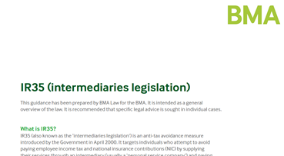
Recent developments – Sessional GPs subcommittee
BMA’s submission to DDRB
Work to address the inconsistent eligibility in death in service benefits
Employment status guidance covering issues such as OOH, IR35 and indemnity
Model terms and conditions for locum GPs
Focus document about T&Cs for doctors employed under new models of care

Slide 27
Recent developments – Sessional GPs subcommittee
Lobby NHS England and devolved administrations through GPC structures to reduce the financial burden of indemnity for sessional GPs in all roles.
Continue to produce guidance on indemnity issues for sessional GPs and LMCs
Supporting LMCs and GPs with local issues

Slide 28
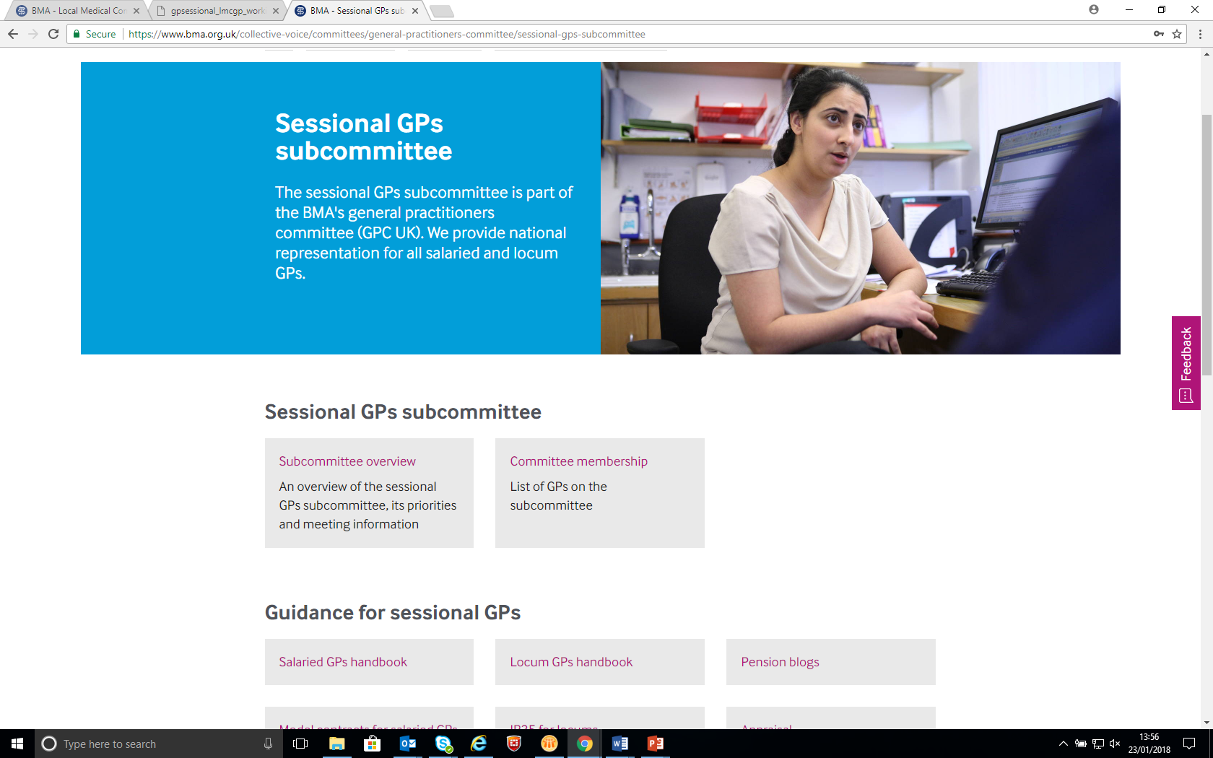
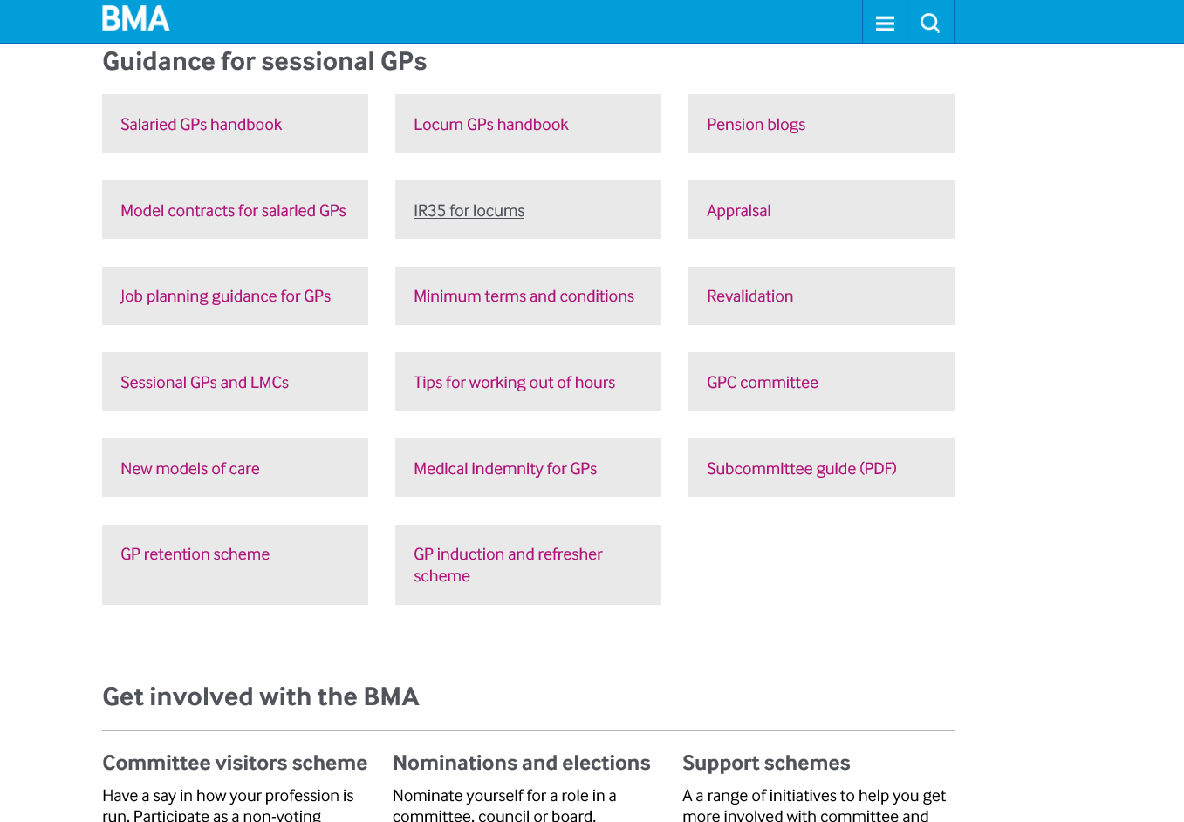
BMA website resources for sessionals

Slide 29
Monitoring GPFV funding delivery
Information to LMCs on available funding/ support
£3/patient CCG transformational funding for general practice
FOI request to CCGs on transformational funding in 2017/18 and 2018/19
Responses sent to LMCs
Follow-up action with NHS England on those not investing this funding
Clarification with NHSE of recurrent and non-recurrent GPFV funding
Short survey in March/ April 2018
Second annual BMA monitoring report May 2018
Notes:
The GPFV policy group is committed to monitoring the implementation and delivery of the GPFV to ensure practices are getting what the GPFV has promised. As part of this, some of the work that we have carried out so far includes:
We issued an informational letter to LMCs at the beginning of the financial year on the funding and support streams that are available for 2017/18. We encourage LMCs to use this to ensure practices are receiving all that is available to them and to inform us of any challenges that are being faced in accessing these.
We issued an FOI request to all CCGs in England to establish how and when they plan to provide the £3 per head transformational funding to general practice.
Most CCGs reported that they will provide this funding, mainly split equally (e.g. £1.50) across two years.
We have sent out a letter to LMCs detailing the responses from CCGs. We encourage all LMCs to check that practices in their area are receiving this funding from their CCG.
It is vital that general practice receives an increase in recurrent funding. Therefore we have sent a written request to NHS England to determine how much of the GPFV recurrent and non-recurrent funding has been and will be spent. We want to ensure funding will continue beyond the GPFV period.
We will be issuing a short, focused survey in March/ April 2018 to LMCs on the 2017/18 funding and support streams. This helps us to establish how the second year of GPFV has been going and if funding is reaching the ground. This information is extremely useful for us to communicate with NHS England what is and isn’t working.

Slide 30
Improving access to general practice
18 transformation areas:
Northumberland, Tyne & Wear; Morecombe Bay; Fylde Coast; Greater Manchester; Dudley; Modality MCP; NH Hants & Farnham; NE Hants & Farnham; Somerset; Isle of Wight; Durham, Darlington & Tees, Richmondshire & Whitby; Harrogate & Rural District; Wakefield; Mid Nottinghamshire; Wakefield; Erewash; Principia South Nottinghamshire; Tower Hamlets; Canterbury & Coastal; Fareham & Gosport, South Eastern Hampshire CCGs.
£138 million available in 2017/18 to support better access
CCGs with GP Access Fund sites will receive £6 per weighted patient in 2017/18 and 2018-19
18 transformation areas asked to accelerate extended access will receive £6 per head in 2017/18
All other CCGs receive £3.34 per head in 2018/19
From 2019/20 all CCGs will receive £6 per head

Slide 31
Other funding/ support in 2017/18
Programme | 2017/18 provision
General practice resilience programme | £8 million
Online Consultation Systems | £15 million
GP Retention Scheme | Practices employing a GP in this scheme will receive £76.92 per session
GP Induction and Refresher Scheme | Practices hosting GPs in this scheme will receive a supervision fee of £8,000 per year FTE
Clinical Pharmacists in General Practice Programme | 583 appointed, 587 more agreed - practices employing CPs will receive £29,000 FTE (£36,000 FTE Senior CPs) which reduces to £0 over three years
Mental Health Therapists | 20 mental health pilots, 400 new IAPT therapists in primary care
International GP Recruitment Programme | Begin recruitment process for 600 doctors
Training for Reception and Clerical Staff | £10 million
Practice Manager Development | Approx. £2.5 million (of £6m)

Slide 32
Collaborative working
Different shapes and sizes – no one size or model fits all
Different threats and opportunities depending on the model:
sustainability , resilience and support for individual practices
workforce support and development
option to expand and integrate primary care services
community services delivery
Does not resolve overall lack of resources
Need for recurrent operating costs to be funded
BMA not promoting any particular model, but can offer support to interested practices

Slide 33
Possible Opportunities and Threats?
Decreased continuity of care
Less autonomy for individual GPs
Risk of transfer of contract
Risk of failure to secure larger community contracts
Strength and resilience in size
Shared support and workload management
Options for workforce development and flexible working
Investment and expanded/new services
Indemnity and governance
Greater influence
Reduced personal liabilities

Slide 34
Federations
Practices working together, in a collective, legal or organisational entity
Different organisational forms:
loose arrangement based on a MoU
company limited by shares or guarantee,
community interest company
limited liability partnership
Different ownership, governance and management structures, to suit local aims and requirements.
In all models individual practices remain independent organisations, but profit, contractual and pension arrangements may vary

Slide 35
Taurus Federation – Herefordshire
LMC initiated
Philosophy to support varied GP landscape (inner-city to very rural) and retain GMS
Plans to resist pressure of ACO/vertical integration by demonstration of viable horizontal approach
Formed an LLC (a company limited by shares), all 24 practices in Herefordshire joined
All practices on EMIS Web, robust data sharing across the Federation
7 day extended services, based around 3 hubs. 53 local GPs work in the hubs
Other developments include: a 'Zero tolerance integrated patient service' with patients seen in the hubs; joint sexual health service; joint workforce strategy and development with clinical pharmacists, Physicians Associate ambassador and apprentices.

Slide 36
Super-partnerships
Practices forming a single business unit, covering multiple sites.
For larger scale super-partnerships likely to involve a partnership agreement and a new structure, eg a company limited by shares, which can hold contracts and limit individual partner liability
Autonomy retained by practices varies according to model (including profit sharing arrangements, retention of P/AP/GMS contracts, GPs’ employment status, structure of the practice)
Single, central structure may enable economies of scale, centralisation and sharing
Large super-partnerships have greater capacity to bid for and deliver extended services, and potentially offer different workforce models and employment options

Slide 37
Our Health Partnership, Midlands and Shropshire
38 practices, population covered 370,0000, originating in Birmingham
Profit Centre model (common in industry, rare in medicine)
Single partnership, with original contracts held centrally in trust
Small central corporate team paid for by levy of £2 per patient (tax deductible)
Considerable local autonomy (both managerially and financially) within each practice
Central functions and economies of scale (back office, central accounting, buyers scheme discounts, reduced indemnity costs, joint training, single CQC inspection)
Shared support for practices (eg peer support, quality team, shared pool of salaried doctors, GP bank, leadership development)
Retain partner and salaried roles, practices retain individual practice managers
Notes:
Profit center: This means that profits are worked out at practice level and shared between the partners at that practice, rather than a super-partnership level and shared between everyone.

Slide 38
Modality, Birmingham (and beyond)
National super-partnership, originating in Birmingham, but now also operating in other regions (Sandwell, Walsall, Hull, Airedale, Wharfedale & Craven, Wokingham and East Surrey) serving 320,000+ population with 120 Partners and >850 staff
Delivers both primary care and outpatient services
Each region manages its own delivery (workforce and financial), supported by centralised back office support (finance, payroll, HR, communications etc)
Joint working on population health (including but not limited to CCGs, Acute Trusts, Community Trusts, Mental Health Trusts, Voluntary Sector, GP Alliances / Federations, Local Authorities)
Notes:
For example: workforce model in Birmingham has three levels of salaried doctors and three levels of partnership.
In Yorkshire practices have retained their existing partnership structure, but have created a pathway with three levels of salaried doctors.

Slide 39
Primary Care Home
Model developed by the NAPC (National Association of Primary Care)
Combined focus on the personalisation of care with improvements in population health, using an integrated multi-disciplinary workforce
Groupings of practices that cover 30 -50,000 people
PCHs are expected to deliver whole population health, host community-based professionals, deliver extended access, deliver holistic, personalised care, be part of a local network delivering urgent and long-term care and reduce unwarranted variation and demand

Slide 40
Granta and Shelford - Cambridgeshire
Three Granta Medical Practices (previously merged) joined with neighbouring Shelford practice to form a primary care home – 42,000 population
Planning a John Lewis-type model of ownership with all staff having a stake in the business
Operational executive of three partners and senior practice management with delegated authority to run the organisation
Developments include:
working with local trust to second their community staff into the PCH; improved communication with the acute trust; collaborative delivery of paediatrics, ENT services and ophthalmology.
professional management and IT support systems; extended surgery hours and increased same day GP access (46% of patients); emergency care paramedics available for home visits; dedicated phone service with a 20-minute call back time

Slide 41
MCPs (multispecialty community providers)
New care model in the Five Year Forward View
Piloted by vanguard sites across the country
Model potentially combining the planning, budgets and delivery of primary and community care services.
Responsible for providing care to the whole population, based on registered lists of participating practices, covering at least 30- 50,000 people

Slide 42
Hampshire – Better Local Care
Spent time building relationships between the local Trusts, GP practices and commissioners
Developments include care navigators, fully funded clinical pharmacists in practices, data sharing and shared IT systems, eConsult, a frailty service, same-day primary care access hubs (calls are triaged by ANP or GP – 40% receive a face-to-face appointment with a GP, nurse or physiotherapist).
Local Trust supported struggling practices in Gosport. Doctors are now employed by the trust on a permanent contract, either at partner or salaried level with indemnity covered
All changes achieved under existing contractual arrangements
Providers and commissioners are starting to work more collaboratively – general practice needs to be part of this

Slide 43
ACOs
NHS England’s focus now on ACOs (accountable care organisations) – similar to MCPs but would likely include secondary care.
Extent of general practice integration will be determined by local GPs – all new contractual options are voluntary.
Key concerns: risk to GP independent contractor status; any ‘right to return’ unlikely to work in reality; locally negotiated employment contracts; financial accountability and risk-gain share arrangements; full contract tendering with risk of private sector winning bid; ongoing funding, workload and workforce challenges
Possible opportunities: more integrated working; better relationships with other providers; possibility of ending of perverse incentives of PBR; clearer patient pathways

Slide 44
Virtually integrated
All contracts and accountabilities remain in place, but overlaid with an alliance agreement outlining how commissioners and providers will work together to create better integration of services.
Enables providers to work in collaboration under existing contracts.
Essentially an ACS (accountable care system) rather than an ACO (accountable care organisation).

Slide 45
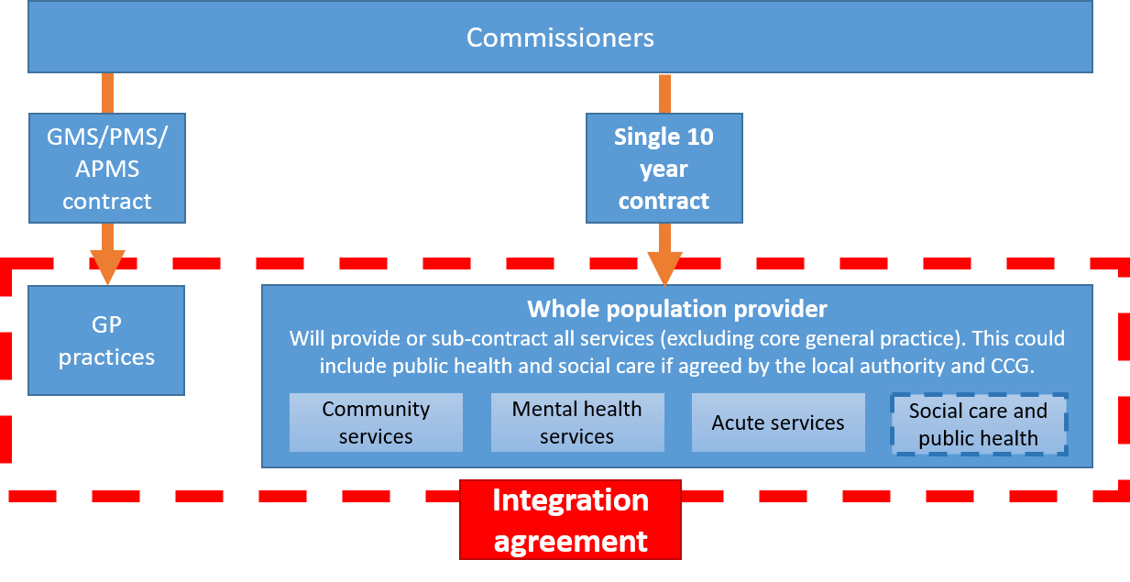
Partially integrated
Single contract held between the commissioners and providers (except core GP services).
Under procurement rules this must be put out to tender.
GP contracts remain in place.
Formal integration agreement between the whole population provider and GP practices to work together.

Slide 46
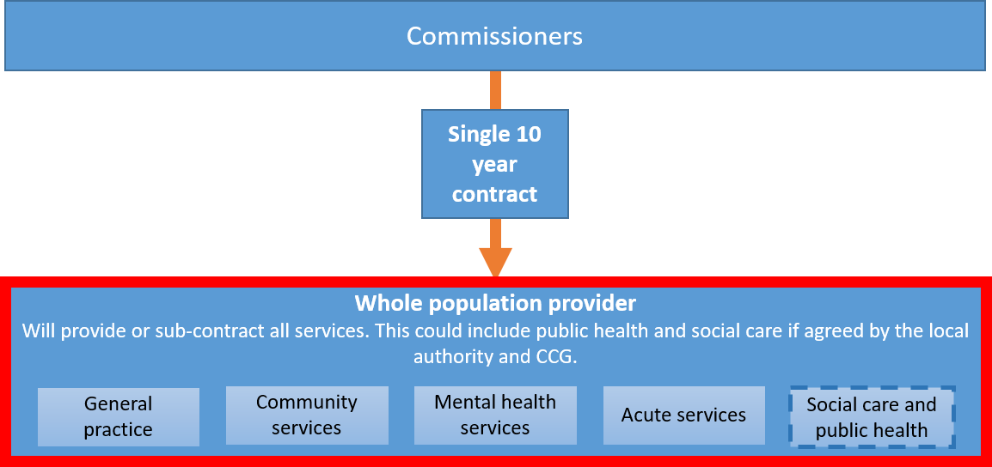
Fully integrated
A single contract between the whole population provider and the commissioners.
Under procurement rules this must be put out to tender.
Provides or sub-contracts all services
An end to GMS/PMS contract

Slide 47
GPC England
Questions?
Contact us: info.gpc@bma.org.uk
sessionalgps@bma.org.uk

