Slide 1
Delivering a sustainable future for General Practice
Richard Vautrey
Chair, BMA GP committee England

Slide 2

Recognition of the problem
NHS Five Year Forward View October 2014
“General practice, with its registered list and everyone having access to a family doctor, is one of the great strengths of the NHS, but it is under severe strain”
“Primary care services have been under-resourced compared to hospitals. So over the next five years we will invest more in primary care”

Slide 3
Funding

Slide 4
Underfunding of healthcare in the UK
Health spend across leading EU countries (2015)

Slide 5

GP Forward View - Published April 2016
£2.4bn by 2020/21
      From £9.6 billion in 2015/16 to over £12 billion by 20/21; 14% real terms increase compared to 8% for rest of NHS
      Includes £500m for extending GP access
£508 million for 5 year Sustainability and Transformation package.
      £56m for practice resilience programme for GPs suffering burnout and stress
      £206m to grow medical and non-medical workforce
      £171m to support practices develop working at scale
  £900m for capital investment
  Action to tackle indemnity costs

Slide 6
Share of NHS funding invested in general practice (England)
Year | % total investment | % excluding dispensed drugs
2004/5 | 10.0% | N/A
2005/6 | 10.4% | N/A
2006/7 | 9.8% | N/A
2007/8 | 9.2% | N/A
2008/9 | 8.7% | 8.0%
2009/10 | 8.5% | 7.8%
2010/11 | 8.3% | 7.7%
2011/12 | 8.2% | 7.6%
2012/13 | 8.0% | 7.5%
2013/14 | 8.0% | 7.4%
2014/15 | 8.1% | 7.5%
2015/16 | 8.3% | 7.7%
2016/17 | 8.5% | 7.9%
NHS budget TDEL, source PESA. GP investment, source HSCIC

Slide 7
GP share of NHS budget – projected change

Slide 8
Funding gap to reach 11% investment target
Investment in general practice (excluding drug reimbursement)

Slide 9
Payments to practices in England 2016/17
(per weighted patient)
GMS - £147.42 (5301 practices)
PMS - £155.06 (2127 practices)
APMS - £224.03 (279 practices)
Average payment - £151.37
Average payment for non-dispensing practice - £142.63

Slide 10
Workforce

Slide 11

GP Forward View - workforce
5,000 extra doctors working in general practice by 2020/21
Increase GP training recruitment to 3,250 a year
500 GPs returning through improving Retainer Scheme and Induction and Refresher (I&R) Scheme
£112m (in addition to the existing £31 million) for clinical pharmacists, leading to a further 1500 pharmacists in addition to the current 470 in general practice by 2020 (one pharmacist per 30,000 population).
3,000 practice-based mental health therapists by 2020 – therapist for every 2-3 typically sized practices
£15m for practice nurse development, over £50m reception, admin staff and practice manager development
1000 physician associates in primary care settings by 2020

Slide 12
GP workforce
London trainee survey 2017
Factors affecting job choice
Next career choice:
Salaried GP 47%
Short-term locum 19%
Long-term locum 18%
Other 12%
Partner 4%

Slide 13
GP Workforce - 5000 more GPs?
    Current reality (excluding locums):
    March 2017 – June 2017
        39,884 GPs, an increase of 224 (0.6%) from 39,660
        33,236 FTE GPs, an increase of 263 (0.8%) from 32,972
    March 2016 – March 2017
        Number of FTE GPs fell by 1252 (-3.7%)
        Number of FTE consultants rose by 1465 (3.4%) to 45,096
        Number of doctors in training rose by 843 (1.7% )to 50,969

Slide 14
GP workforce numbers

Slide 15
Workforce initiatives
Medical school expansion
25% increase in medical student places
Priority for general practice and psychiatry recruitment
Targeted enhanced recruitment scheme
£20,000 salary supplement to recruit GP trainees to hard to recruit areas
2016 – 126 offered with 109 places filled
Expansion of scheme to cover 200 places in 2018

Slide 16
Induction and refresher scheme
    Increased monthly bursary for doctors from £2,300 to £3,500
    £1,250 to assist with indemnity & £464 for GMC membership and DBS fees
    Removal of assessment fees for first time applicants (worth up to £1,000)
    Reduction in length of placements for those scoring the highest bands
    Reduction of around 20% in number of applicants sitting the simulated surgery
    Increased frequency of the MCQ assessments to every six weeks (from every three months).
    June 2017
        489 applied to join I&R
        120 completed and able to practice without conditions
        183 currently on scheme
    *Further review of scheme expected this autumn

Slide 17
GP Retention Scheme
For GPs considering leaving or have left general practice
Retained GPs receive an annual professional expenses supplement of £1,000 to £4,000 dependent on number of sessions they do
£76.92 per session (up to 4 per week)
We now need to look for ways to support the retention of GP partners
GP Career Plus pilots
    testing different approaches to retaining older GPs in 11 localities
    interim reports soon

Slide 18
International GP recruitment
Increased target for international recruitment from 500 to 2000 doctors by 2020.
Expanding current recruitment programme from the European Economic Area (EEA)
Framework Agreement of International Recruitment Providers to identify potential overseas doctors and support them through recruitment process.
Establishing a GP International Recruitment Office to coordinate the recruitment, support for, and relocation of recruited doctors
Encouraging current IMGs to consider applying for GP training places
NHS England to be the proxy employer for visa sponsorship purposes, removing the burden from local practices to negotiate with the Home Office

Slide 19
Clinical Pharmacists in General Practice
    July 2015 – pilot as part of General Practice Workforce 10 Point Plan
    £112 million co-funding programme started January 2017
    Practices receive partial, tapered funding for 3 years
    1061 practices, (covering nearly 18.5 million patients) were approved in the first two waves of applications
    Third wave closed at end of September 2017
    520 WTE clinical pharmacists in over 1,790 GP practices (when combined with the numbers from the pilot)
    We need sustainable funding for a genuine workforce expansion

Slide 20
Other GPFV workforce commitments
  Mental health therapists
    Extra 3000 in primary care to expand IAPT programme by 2020
    Majority of expansion will be new integrated services
    Employed by existing IAPT providers but based in general practices or within primary care based teams
Physicians Associates
    Consultation on regulation

Slide 21
Other GPFV workforce commitments
Practice manager development
    £6m over 3 years
    NHS England are looking to provide funding to support
        subscriptions to the Practice Manager Network
        development of best practice resources for GP practice management
        peer appraisals
        coaching and mentoring
    Networking events have been held around the country.
Reception and clerical staff
    Training in active signposting and management of clinical correspondence
    £45 million over five years - £5 million allocated in September 2017, followed by £10 million in July 2018

Slide 22
Workload

Slide 23
Managing and reducing workload
The UK population is projected to reach 70 million by mid-2027
    In 2015 11.8m people aged 65+ and 1.5m aged 85+
    By 2020 increased by – 1.1 million 65+, over 300,000 85+
    By 2039 increased by – 9.9 million 75+, 3.6 million 85+
Significant increases in NHS activity across the UK:
    Consultation rates for GPs in England rose by 13.6% between 2007 and 2014 (Oxford University, 2016).
    Consultations numbers increased by more than 15% between 2010/11 and 2014/15 (Kings Fund 2016).
    In Scotland consultations rose by 3.9% from 15.6 million to 16.2 million between 2003 and 2013 (ISD, 2013).
    In Northern Ireland, total general practice consultations rose from 7.2 million in 2003/04 to 12.7 million in 2013/14 (BMA, 2015).
  *There has been no routine public reporting of GP activity data and no standardised national dataset to date – new NHS England data collections are currently in progress in England.

Slide 24
Supporting GPs and practices in crisis
Practice resilience programme
£16 million committed for 2016/17 > £17.2m spent on 1279 practices
£8m available in 2017/18
GP Health Service
Launched January 2017
Case load of 846 GP patients by end of September 2017

Slide 25

Managing and reducing workload:
Primary-secondary care interface
Changes to the standard hospital contract 2015/16 and 2017, for example:
        hospitals are responsible for providing patients with fit notes
        hospitals to provide discharge summaries within 24 hours
        Hospitals to stop asking GPs to re-refer DNA appointments
Helping practices and LMCs hold CCGs and trusts to account, by providing template letters to report and push back on breaches
Working with NHS England to communicate changes to trusts and patients (eg new patient facing leaflet)
Notes:
NHS standard contract changes:
2016/2017
Referrals - Hospitals to stop asking GPs to re-refer DNA appointments; - Hospital to make internal referrals for related problem and not ask GP to re-refer
Communication with the patient and fit notes - Hospital to follow up investigations and inform patient
Discharge summaries - Discharge summaries within 24 hours
Clinic letters - Clinic letters within 14 days
Drugs - Adequate supply drugs on discharge
2017/2018
Communication with the patient and fit notes - Hospital to put in place arrangements for handling patient queries (from patients and GPs); - Hospital to issue fit notes to patients where needed
Discharge summaries - Discharge summaries from A&E within 24 hrs and direct electronic
transmission from Oct 2018
Clinic letters - Clinic letters within 10 days (April 2017) and 7 days (April 2018) and move to electronic transmission using structured clinical headings (Oct 2018)
Drugs - Hospitals to provide medication following clinic attendance

Slide 26
Managing and reducing workload
Safe working in general practice and ‘black alerts’
Define a safe workload and how GPs can alert the wider health and care system when workloads breach safe limits
Create a map of hotspots to show frequency and location of breaches of safe working.
Quality first
Expand the current suite of resources with renewed guidance templates
Unresourced work
Identify all routes of unresourced/unfunded workload to inform discussions on reducing this flow
Explore developing a ‘get a note from your doctor’ resource for GPs.
Selfcare and social prescribing
Create an online resource featuring good practice examples of self-care and social prescribing.

Slide 27
Contracts

Slide 28
Delivering new funding – 16/17 contract
Expenses funded and 1% pay uplift
CQC fees - £15m
Indemnity - £33m
National Insurance contributions - £56m
Superannuation - £14m
Increase to V&I IoS fee from £7.64 to £9.80 - £30m
Increased QOF point value (CPI adjustment) - £14m
£220m - more than double 2015/16 investment and seven times 2014/15
Additional £102m for population growth and local schemes
Overall total of £322m new funding (4.4% increase)

Slide 29
Contract changes – 2017/18
Expenses funded and 1% pay uplift
Indemnity rise paid (£30m)
CQC fees fully reimbursed
Sickness payments guaranteed
Superannuation 0.08% pension admin charge (£3.8m)
Overseas visitors changes admin workload (£5m)
Learning Disabilities ES - increase from £116 to £140 per health check
Morbidly obese influenza vaccination programme (£6.2m)
Bagging and labelling records (£2m)
Workforce census (£1.5m)
Business improvement district levies reimbursement (£1m)
Increase to QOF point value in line with CPI adjustment (£13m)
Population growth funded (£58.9m)
£238m investment into GP contracts for 2017/18

Slide 30
Premises
Premises Cost Directions
Negotiations ongoing for last three years
Anticipated agreement by early November
To include:
  100% grants to allow ETTF funding to flow more easily
  Increased protections for contractors
  Last partner standing protections
  Updated rent review process
NHS PS / CHP
Service charge increases – BMA legal team working on this
STDL/VAT paid if sign up to standard lease – seeking an extension to programme

Slide 31
QOF in England advisory group
Comprised of: DH, NHS England, NHS Employers, NHS CC, NICE, PHE, RCGP and GPC advising on review of QOF
Started in July 2017 with aim to report by June 2018
  How QOF currently works and its impact (within and outwith the GP contract)
  Context and future direction for QOF (making any system future-proof)
  Reformed scheme – how could it work (QOF stays, amended QOF, new QOF, new system?)
  Detailed analysis, impact assessment – are proposals better than current QOF?
July 2018 onward – negotiations and potential implementation

Slide 32
PCSE/Capita
Issues
Performers list (information, additions and removals)
Payments to practices incorrect (LMC levy, salary reimbursements etc)
Pensions payments (processing, receipts, annual reports)
Movement of medical records (delays)
Resolutions
Meeting with PCSE/NHS England/NHS pensions to resolve issues and ensure better planning
Template letters for practices
Escalating individual cases to NHS England and PCSE for urgent resolution
Survey of practice/GPs to obtain data on all service lines
Influencing PCSE in their preparations for the future

Slide 33
MCPs “not the only game in town”
  Aims of MCP/ACO model can be implemented without practices relinquishing their GMS/PMS contracts
  Working at scale can be achieved by GPs working collectively through a variety of models:
      Formal or informal networks
      Federations
      Locality teams
      Collaborative partnerships between local health organisations
      Super partnerships
      Primary care home models

Slide 34
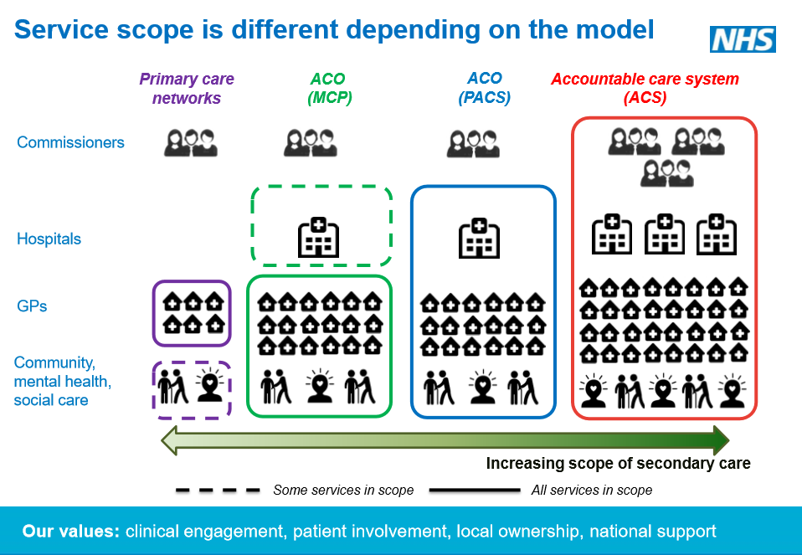
Accountable care systems & Accountable care organisations
Accountable
Whole population
Single budget
Competitive tender
Salaried and managed service?
Three drivers:
Recognition in England that current system set out in 2012 Health & Social Care Act isn’t working
Could a ‘population health’ approach deliver improved care for patients?
Financial constraints

Slide 35
Where we are now

Slide 36

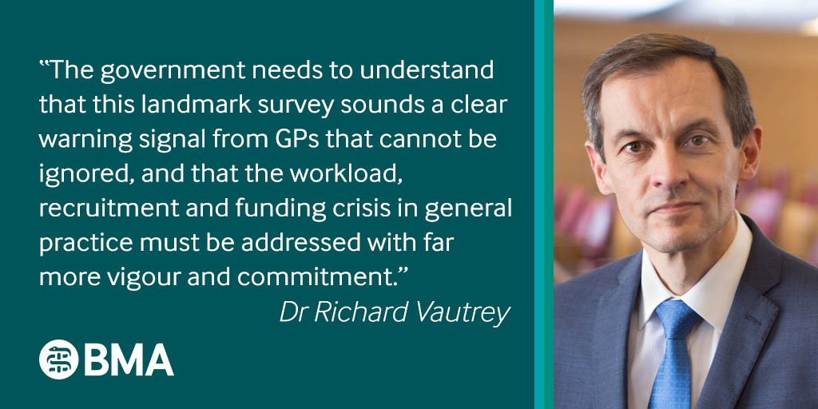
List closure survey
Turnout | 23.9%
 | Yes (% of respondents) | Yes (% of all practices) | No (% of respondents) | No (% of all practices)
Temporary suspension of patient registration | 53.74% | 12.84% | 46.26% | 11.05%
Application for formal list closure | 43.96% | 10.5% | 56.04% | 13.39%

Slide 37
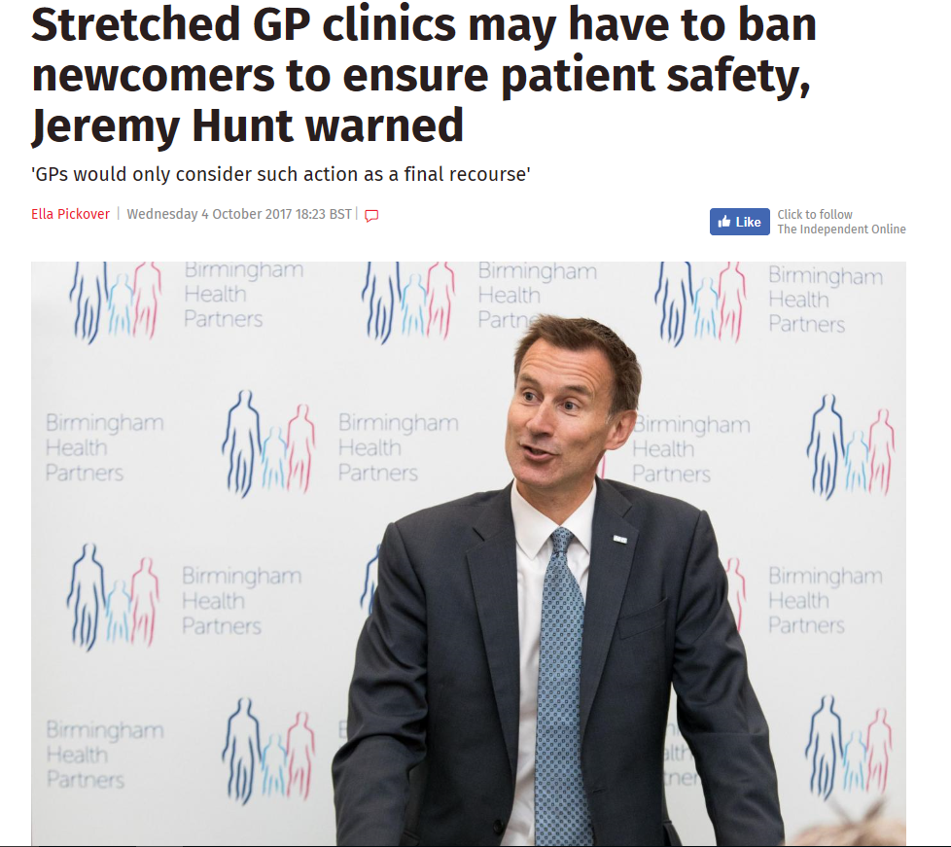

We wrote to the Secretary of State

Slide 38
State backed indemnity scheme
Clinical negligence cover to providers of GP services (including OOH providers of GP services)
Available to all contractors: GMS, PMS and APMS plus any other integrated urgent care delivered through NHS Standard Contracts
Includes GP contractors, salaried GPs and locums
Includes practice staff and other medical professionals working for the practice in the provision of contracted services, and students/trainees working in this area
Decisions yet to be made about inclusion of doctors working in other public sector settings including prisons and the MOD – GPC will be pressing for all GPs to be covered
12-18 months to establish – GPC will be fully involved in its development

Slide 39
Clinical peer review
Elective Care High Impact Interventions: Clinical Peer Review
    CCGs were directed to implement internal prospective clinical per review for practices by Sep 2017
GPC England guidance issued
NHS England have now changed their position and new letter issued to CCGs
Clinical peer review will not apply to all practices or referrals, nor will these plans be mandatory on all CCGs

Slide 40
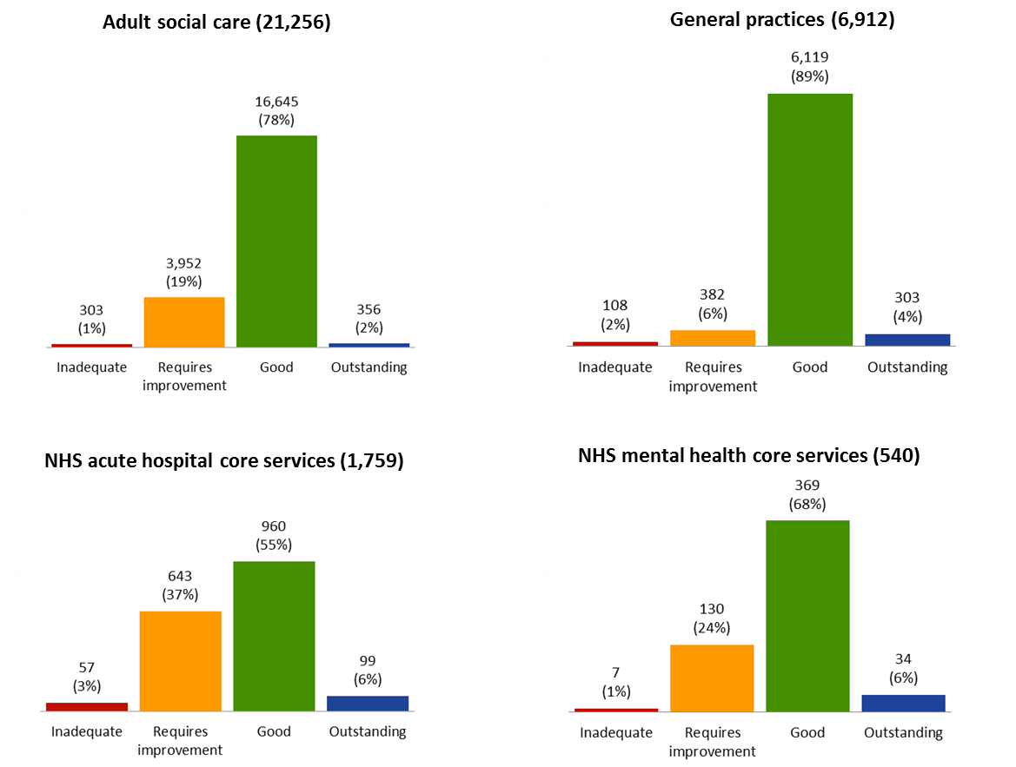
CQC ratings as at 31 July 2017

Slide 41

CQC report – State of Care in General Practice
GPs provide the highest quality care (93% good or outstanding compared to 71% for acute trusts and 74% for NHS core mental health)
Report warned that increased funding in general practice was vital to avoid a significant deterioration in services
General practice is delivering over 90% of all patient contacts on just 7.9% of overall NHS budget

Slide 42
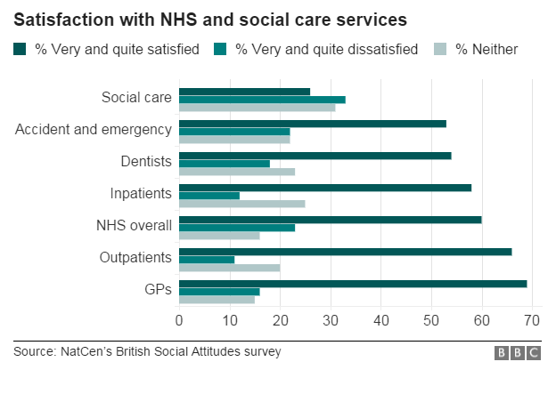
Maintaining GP popularity with patients

Slide 43

Towards a healthier future for General Practice
Sustained and significant funding investment
More GPs, nurses, clinicians and support staff
Highly skilled practice management
Manage workload enabling quality consultations
Building collaborative teams in each locality
Premises and IT development
Promotion of General Practice
Culture change in the NHS

